Slide 1

Applied Data science Masters portfolio
M
S
D
S
Andrea Brennan

Slide 2
About ME
Data Analyst at a Fortune 10 company with 20 years experience in Information Technology with a strong focus on Data Mining, Data Analysis and Data Management.
Applied Masters in Data Science from the School of Information Studies at Syracuse University in 2022

Slide 3
Projects
Us vaccination rates
IST 722 Quantitative Reasoning in Data Science
Women’s clothing in e-commerce
IST 707 Data Analytics
Image Classification Algorithms
IST 718 Big Data Analytics

Slide 4
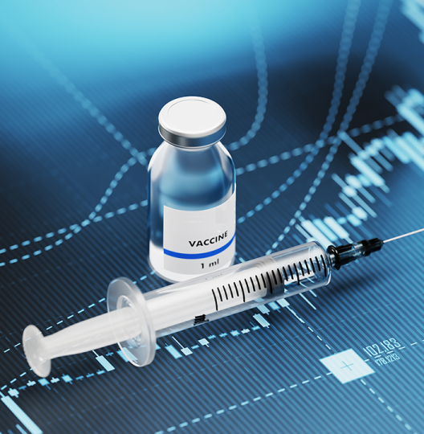
Us vaccination rates
challenge
Analyze 3 vaccination data sets to determine recommendations for asset allocation to increase vaccination rates and school district reporting completion.
deliverables
Write up a technical report for a scientifically knowledgeable staff member in a state legislator’s office. Provide sufficient numeric and graphical detail that the staff member can create a comprehensive briefing for a legislator.
Analysis and modeling used
Change Point Analysis
Correlation Analysis
Logit Regression (Frequentist & Bayesian)
Chi-Squared Testing

Slide 5
Data sets
1) Us vaccination DATA
2) CA Kindergartens
3) districts
Vaccination rates from 1980 - 2017 for diphtheria/pertussis/tetanus, Hepatitis B, Polio, Influenza, and Measles
A list of California kindergartens and whether they reported vaccination data to the state in 2013
A sample of California school districts from the 2013 data collection along with specific numbers and percentages for each district
5 features, 38 observations
13 features, 700 observations
3 features, 7381 observations

Slide 6
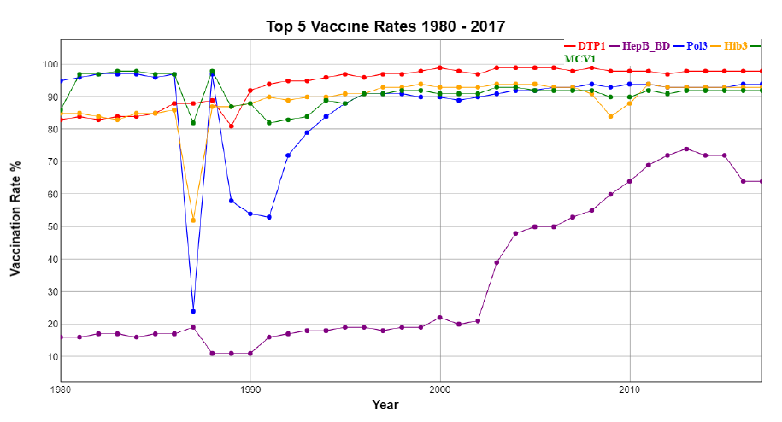
Top 5 Vaccination rates in the us 1980 - 2017

Slide 7
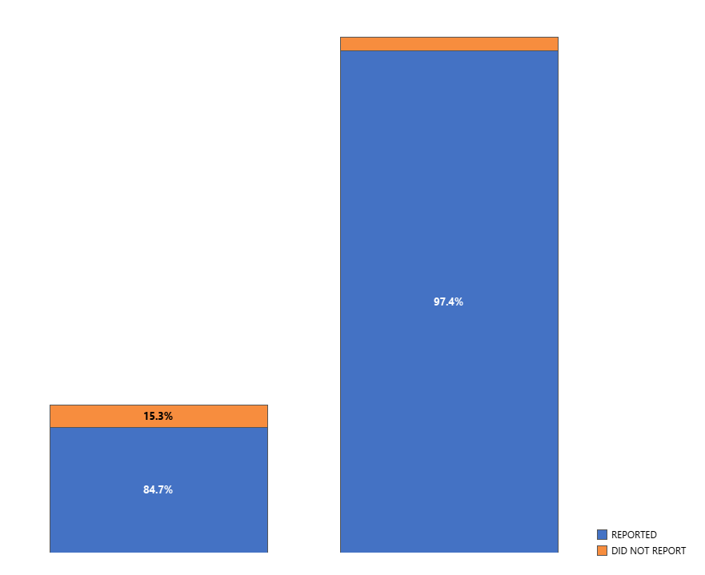
Vaccination Reporting by School Type

Slide 8
TOP predictors
Number of schools in a district
The larger the number of schools in a district, the lower the number of schools completed reporting
Students receiving a free meal
Students receiving a free meal were less likely to have belief exceptions for the vaccine
Students in family poverty
Students with families reporting at the poverty level were less likely to be vaccinated

Slide 9
Recommendations
Make time allowances for larger districts
Reduce number of schools per district or distribute additional resources to larger districts for reporting completion
Perform additional analysis on completion process blockers
Incentivize private school reporting compliance
Apply financial assistance toward family poverty programs and free meal programs

Slide 10

Women’s Ecommerce Clothing reviews
CHALLENGE
Utilize various data analytics techniques to understand how online retailers could increase sales and market share for women’s clothing products
Analysis AND MODELING TECHNIQUES
Sentiment Analysis
Association Rule Mining
K-Means Clustering
Support Vector Machine Analysis
Naïve Bayes Analysis
Random Forests
Decision Trees

Slide 11
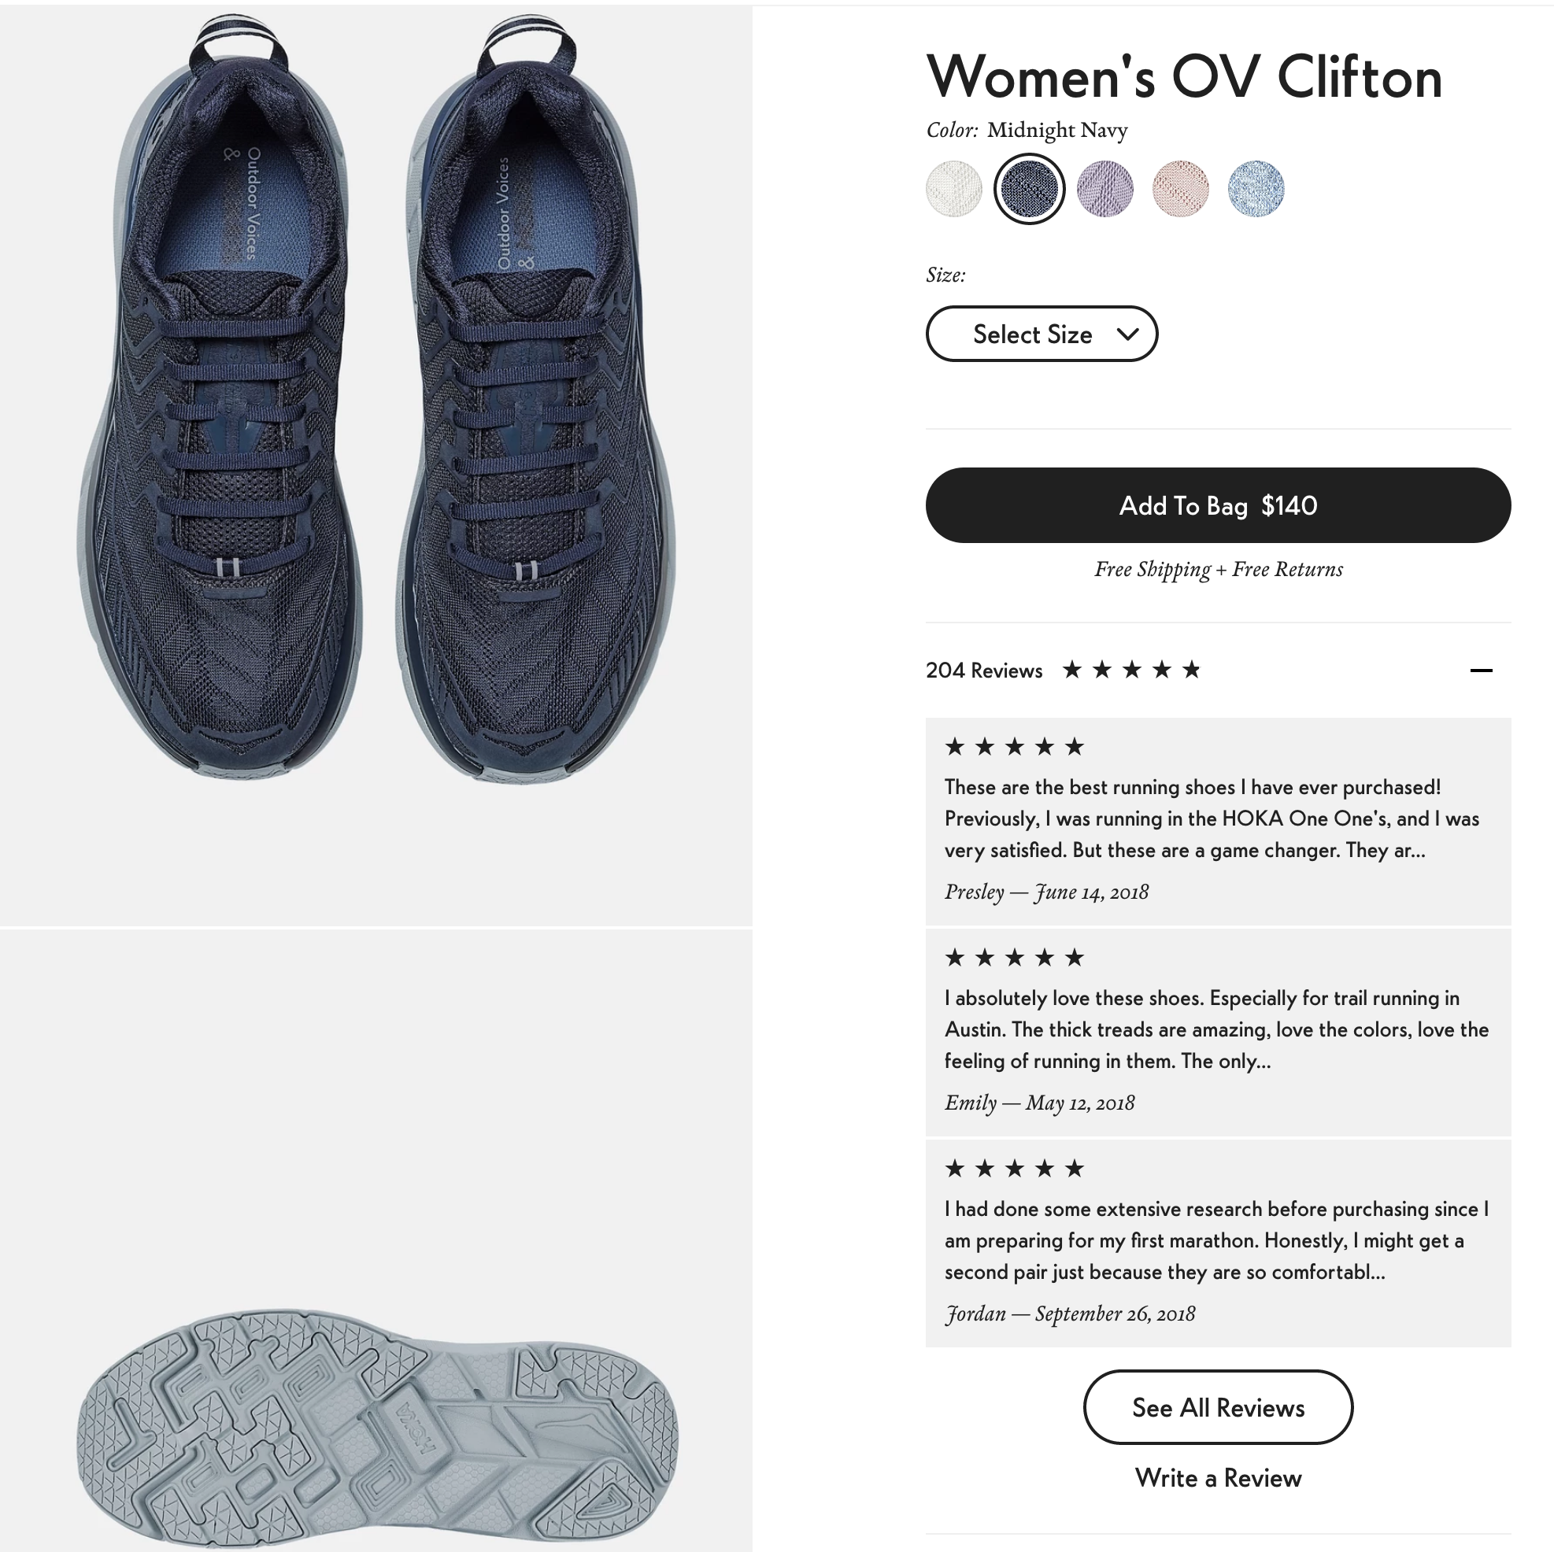
Women’s E-Commerce Clothing Reviews Dataset
This dataset includes 23486 rows and 10 feature variables. Each row corresponds to a customer review, and includes the variables:
Clothing ID: Integer Categorical variable that refers to the specific piece being reviewed.
Age: Positive Integer variable of the reviewers age.
Title: String variable for the title of the review.
Review Text: String variable for the review body.
Rating: Positive Ordinal Integer variable for the product score granted by the customer from 1 Worst, to 5 Best.
Recommended IND: Binary variable stating where the customer recommends the product where 1 is recommended, 0 is not recommended.
Positive Feedback Count: Positive Integer documenting the number of other customers who found this review helpful.
Division Name: Categorical name of the product high level division.
Department Name: Categorical name of the product department name.
Class Name: Categorical name of the product class name.
Example review from a women’s retailer
Data Source: https://www.kaggle.com/nicapotato/womens-ecommerce-clothing-reviews

Slide 12
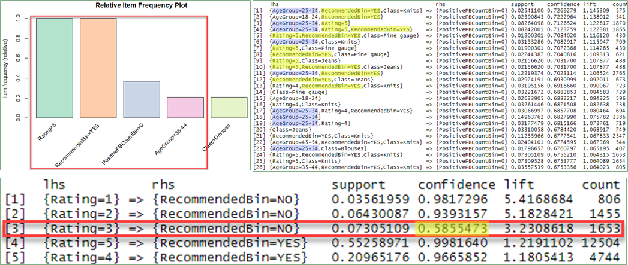
Analysis: Association Rule Mining
Rating = 5 => Recommended = YES
Age Group = 35-44
Ratings = 1, 2 & 3 => Recommended = NO
Rating 1 & 2 = 94-98% confidence/accuracy
Rating 3 = 58.6% confidence/accuracy
Notes:
A lot of correlations you would expect…
Ratings 1 & 2 strongly associated w/ Recommendation of NO.
Rating of 3 had confidence level/accuracy of 58.6% of association w/ a Recommendation of NO.
Ratings of 3 are far more split between recommendations.
Rating 3 customers could be incentivized to sway their recommendation of a product.
Association rules with the highest confidence/or accuracy were between Ratings of 5 and Recommended = Yes.
Top 6 rules with 100% confidence, 5 were also associated with the age group 35-44
This age group was the most likely to recommend a product and give a higher rating than most.

Slide 13
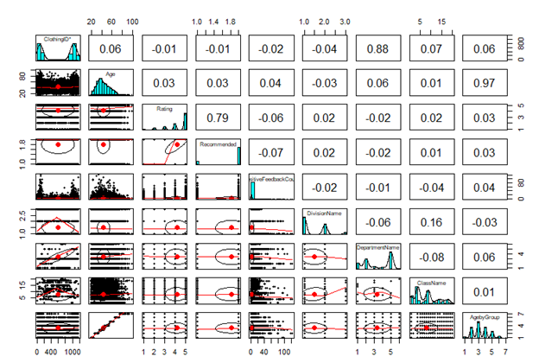
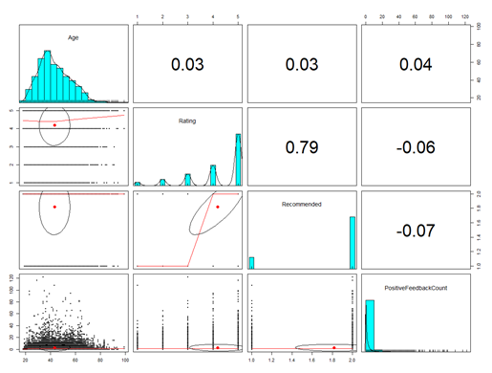
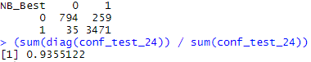
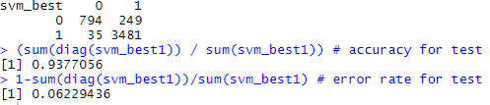
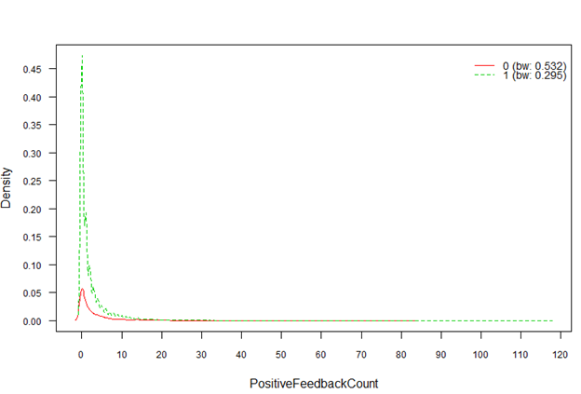
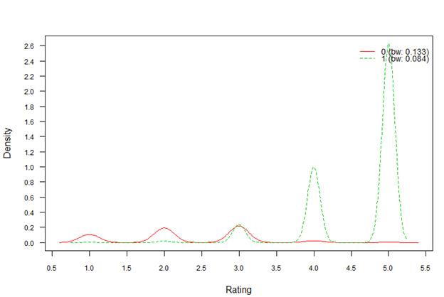
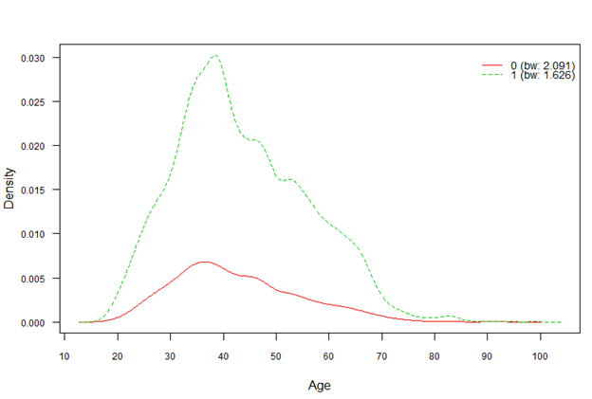
Analysis: Naïve Bayes and SVM Models

Slide 14
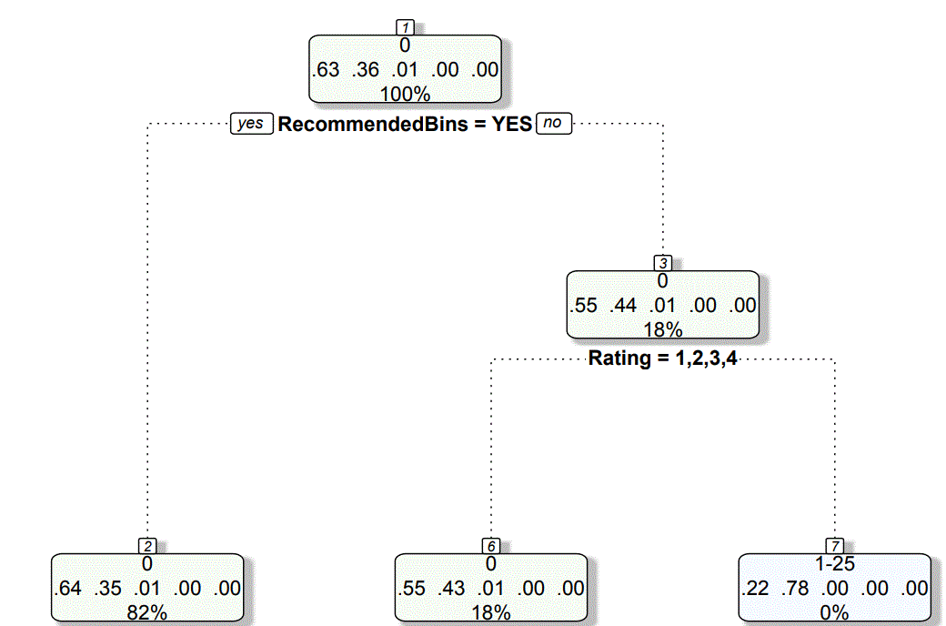
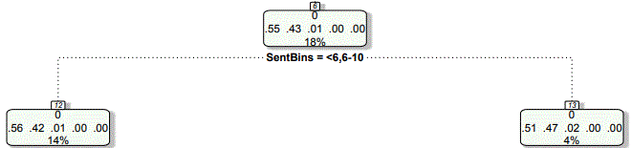
Identifying what makes for an impactful review
1+ Positive Feedback Count
37% of reviews marked as helpful
Helpful reviews were either:
Those w/ recommendations (82%)
OR
Got a <5 Star Rating (18%)
Lower rating was accompanied by a lower text review sentiment score 78% of the time
Recommended
Not Recommended
1-4 Rating
5 Rating
Low Sentiment
High Sentiment

Slide 15
Conclusions and Recommendations
Develop new marketing plans based on:
Age Segmentation - Under 40 vs Over 40
Sentiment Scores
Target top tier of scores with special offers for new items
Target low tier of scores with discounts & volume purchase promotions
Improve customer service based on Ratings of 3

Slide 16
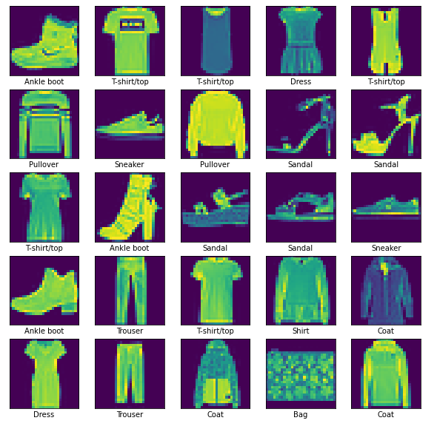
Algorithm Comparisons – Image Classification
CHALLENGE
Classify images of clothing products using various algorithms to analyze the trade-offs of each approach from the accuracy and performance perspectives
Models used
Neural Network
Decision Tree
Random Forest
KNN
Naïve Bayes

Slide 17
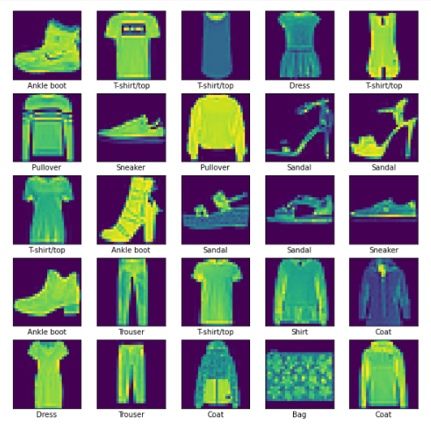
Data Set
Fashion MNIST data set
60,000 training set images and 10,000 test 28x28 images
10 classifications:
T-shirt/top
Trouser
Pullover
Dress
Coat
Sandal
Shirt
Sneaker
Bag
Ankle boot

Slide 18
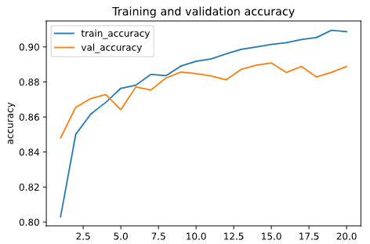
Neural Network Classification
Approach
Results
SELU activation
Early stopping
Monitor = val_accuracy
Patience = 5
Accuracy: 88.4%
Processing Time: ~91 seconds
Extensive hyperparameter tuning

Slide 19
Decision Trees & Random Forest
Decision Trees
Accuracy: 78.93%
Processing Time: ~49 seconds
Minimal setup
Random Forest
Accuracy: 88.0%
Processing Time: ~93 seconds
Minimal setup

Slide 20
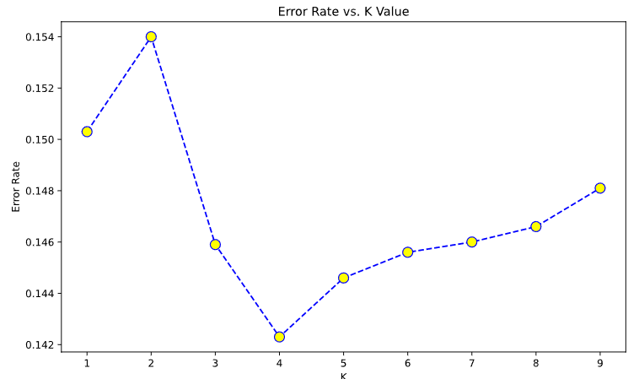
K-Nearest Neighbors
Accuracy: 85.77%
Processing Time: ~40 seconds
Additional setup time required to identify K Value

Slide 21
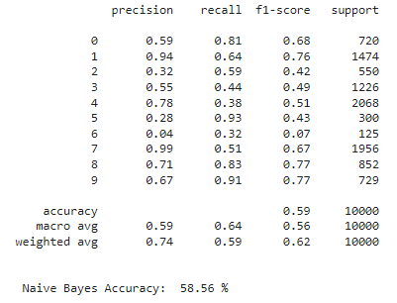
Naïve Bayes
Accuracy: 58.56%
Processing Time: ~1 second
Minimal setup

Slide 22
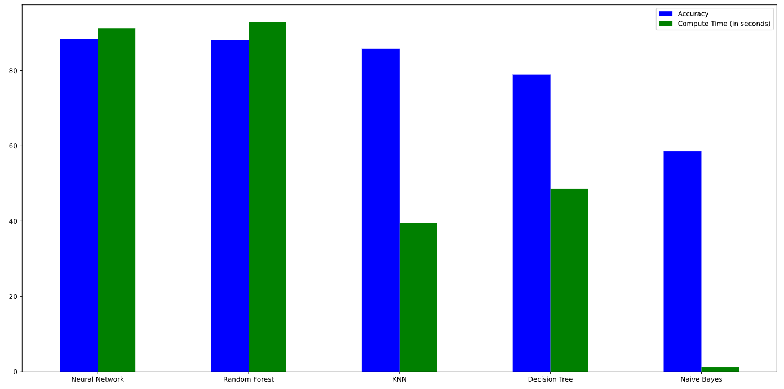
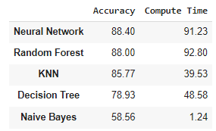
Algorithm Comparison
Accuracy & Compute Times
Pros/Cons
Neural Network – longest setup time w/ tuning of hyperparameters
Random Forest – minimal setup w/ second best accuracy
KNN – mid-range accuracy, elbow plotting to find N
Decision Tree – second to worst accuracy
Naïve Bayes – fastest performance, lowest accuracy

Slide 23

Thank you
Andrea Brennan​
DataGeek42@gmail.com
803-319-8289

